Slide 1
Fitting Neural Networks 2

Slide 2
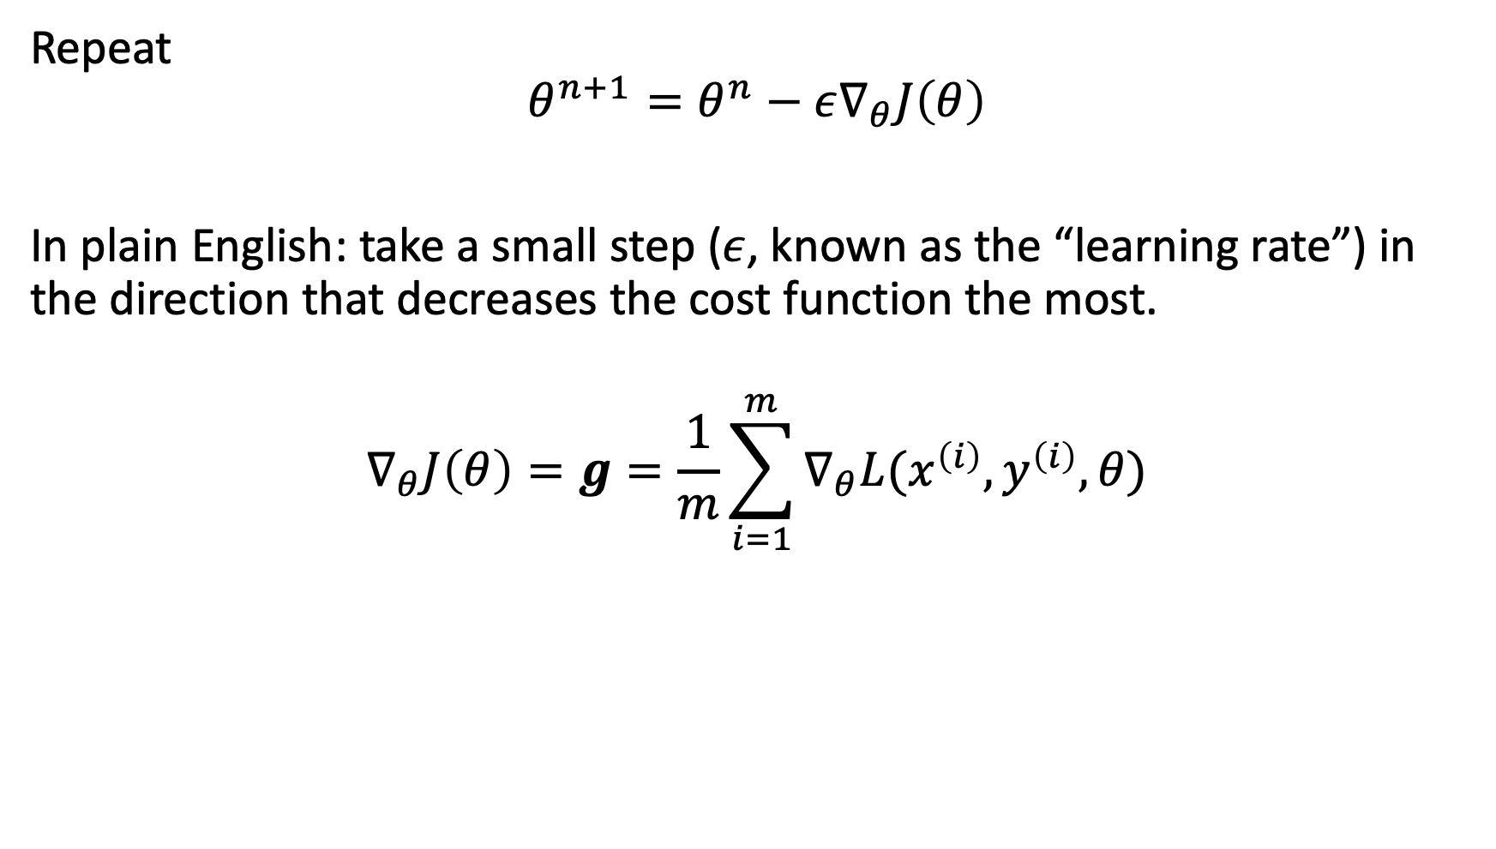
Review: Stochastic Gradient Descent Algorithm
Repeat
$$θ^{n+1}=θ^{n}−ε∇_{θ}J\left(θ\right)$$
In plain English: take a small step ($ε$, known as the “learning rate”) in the direction that decreases the cost function the most.
$$∇_{θ}J\left(θ\right)=g=\frac{1}{m}\sum_{i=1}^{m}{∇_{θ}L(x^{\left(i\right)},y^{\left(i\right)}, θ)}$$

Slide 3
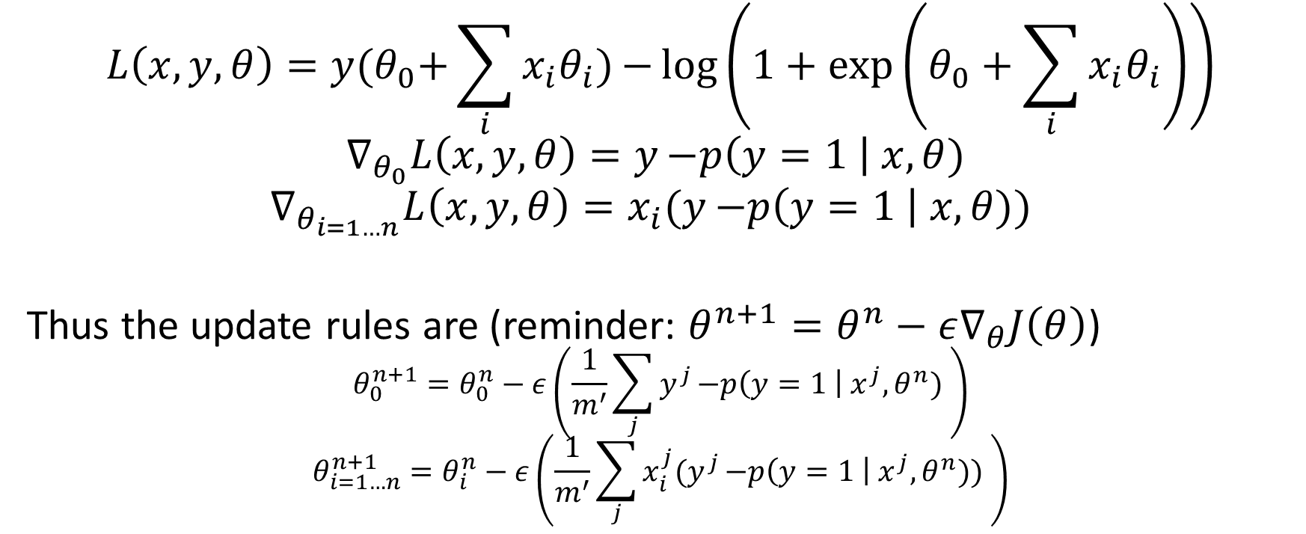
Review: Logistic Regression
$$L\left(x, y, θ\right)=y{(θ}_{0}+\sum_{i}{x_{i}θ_{i}}){−\log\left(1+\exp\left(θ_{0}+\sum_{i}{x_{i}θ_{i}}\right)\right)}$$
$$∇_{θ_{0}}L\left(x, y, θ\right)=y{−p\left(y=1 \right| x, θ) }$$
$$∇_{θ_{i=1…n}}L\left(x, y, θ\right)=x_{i}(y{−p\left(y=1 \right| x, θ)) }$$
Thus the update rules are (reminder: $θ^{n+1}=θ^{n}−ε∇_{θ}J\left(θ\right)$)
$$θ_{0}^{n+1}=θ_{0}^{n}−ε\left(\frac{1}{m^{′}}\sum_{j}{y^{j}{−p\left(y=1 \right| x^{j}, θ^{n}) }}\right)$$
$$θ_{i=1…n}^{n+1}=θ_{i}^{n}−ε\left(\frac{1}{m^{′}}\sum_{j}{x_{i}^{j}(y^{j}{−p\left(y=1 \right| x^{j}, θ^{n})) }}\right)$$

Slide 4
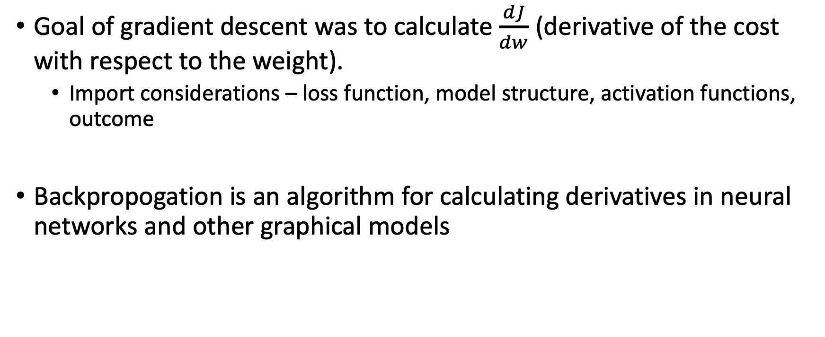
Backpropogation
Goal of gradient descent was to calculate $\frac{dJ}{dw}$ (derivative of the cost with respect to the weight).
Import considerations – loss function, model structure, activation functions, outcome
Backpropogation is an algorithm for calculating derivatives in neural networks and other graphical models

Slide 5

Calculus Review: Chain Rule
If
$$y=f(g(x)$$
Then
$$\frac{dy}{dx}=f^{′}\left(g\left(x\right)\right)g′(x)$$

Slide 6


Calculus Review: Chain Rule
For instance
$$y=\frac{1}{1+e^{−x}}$$
$$f\left(x\right)=\frac{1}{1+x}$$
$$g\left(x\right)=e^{x}$$
$$h\left(x\right)=−x$$
$$\frac{dy}{dx}=\frac{e^{−x}}{{\left(1+e^{−x}\right)}^{2}}$$
$$f^{′}\left(x\right)=−\frac{1}{{\left(1+x\right)}^{2}}$$
$$g^{′}\left(x\right)=e^{x}$$
$$h^{′}\left(x\right)=−1$$

Slide 7

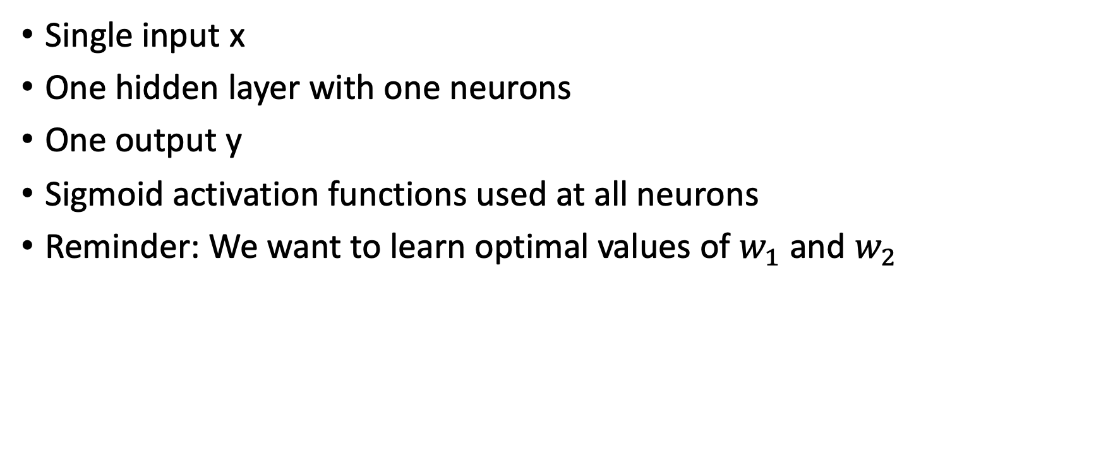


Consider a Simple Neural Network
Single input x
One hidden layer with one neurons
One output y
Sigmoid activation functions used at all neurons
Reminder: We want to learn optimal values of $w_{1}$ and $w_{2}$
x
$$w_{1}$$
h
$$w_{2}$$
$$\hat{y}$$

Slide 8
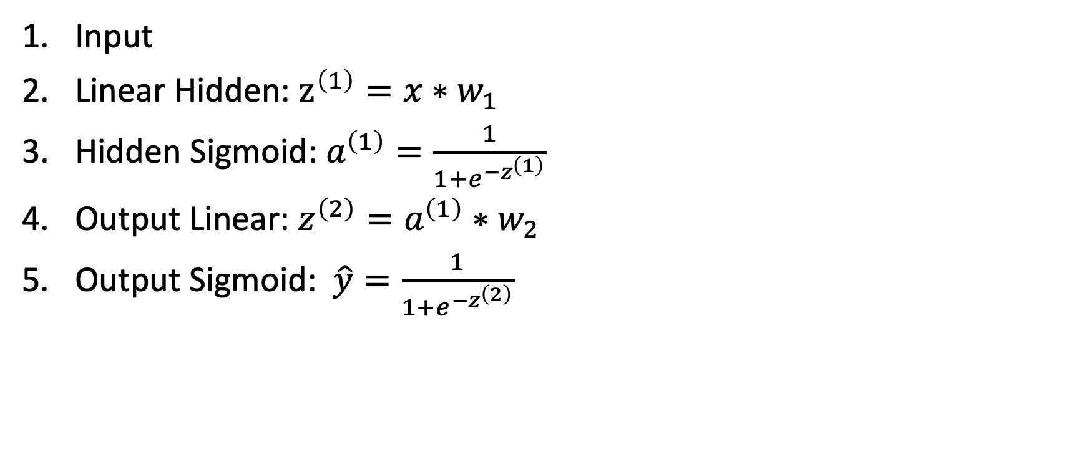
Consider a Simple Neural Network
Input
Linear Hidden: $z^{\left(1\right)}=x∗w_{1}$
Hidden Sigmoid: $a^{\left(1\right)}=\frac{1}{1+e^{−z^{\left(1\right)}}}$
Output Linear: $z^{\left(2\right)}=a^{\left(1\right)}∗w_{2}$
Output Sigmoid: $\hat{y}=\frac{1}{1+e^{−z^{\left(2\right)}}}$
x
$$w_{1}$$
h
$$w_{2}$$
$$\hat{y}$$

Slide 9
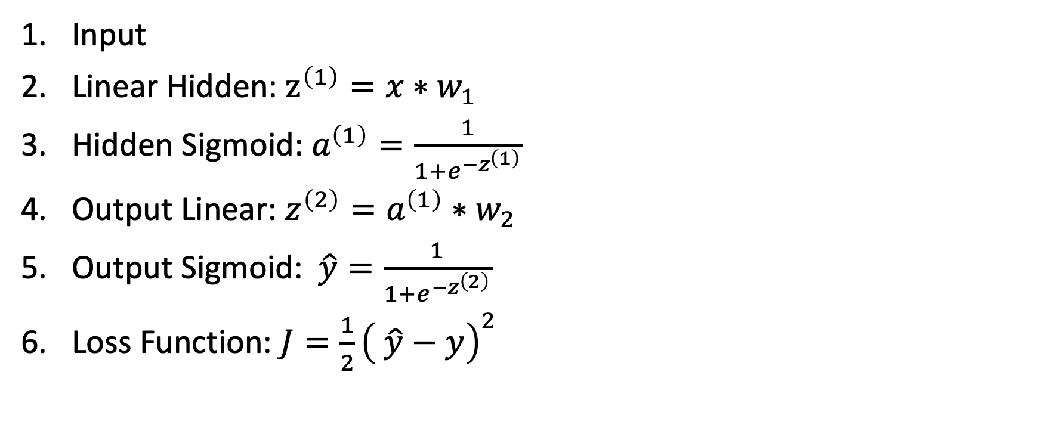
Consider a Simple Neural Network
Input
Linear Hidden: $z^{\left(1\right)}=x∗w_{1}$
Hidden Sigmoid: $a^{\left(1\right)}=\frac{1}{1+e^{−z^{\left(1\right)}}}$
Output Linear: $z^{\left(2\right)}=a^{\left(1\right)}∗w_{2}$
Output Sigmoid: $\hat{y}=\frac{1}{1+e^{−z^{\left(2\right)}}}$
Loss Function: $J=\frac{1}{2}{\left( \hat{y}−y\right)}^{2}$

Slide 10

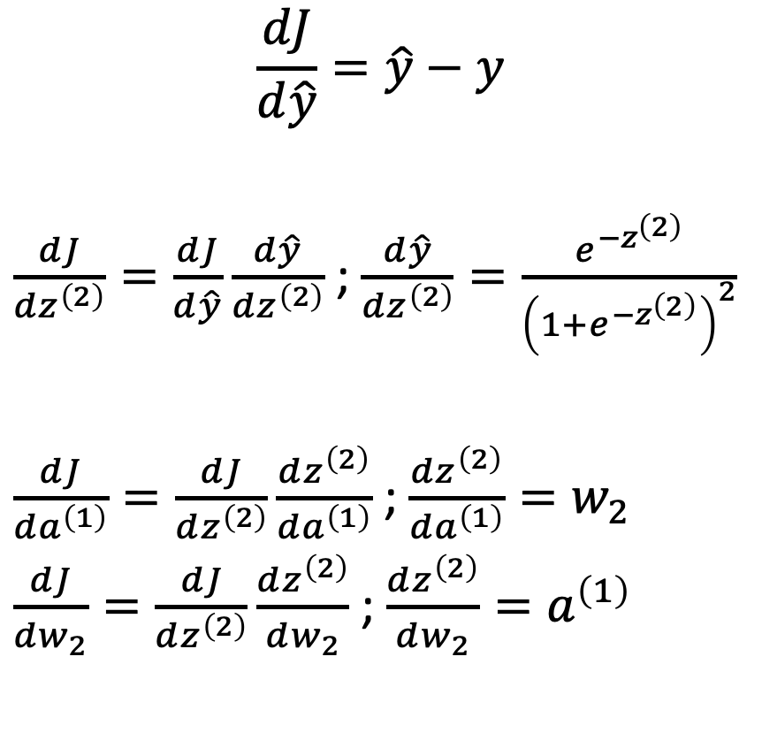
Backpropogation
$$J=\frac{1}{2}{\left(\hat{y}−y\right)}^{2}$$
$$\hat{y}=\frac{1}{1+e^{−z^{\left(2\right)}}}$$
$$z^{\left(2\right)}=a^{\left(1\right)}∗w_{2}$$
$$\frac{dJ}{d\hat{y}}=\hat{y}−y$$
$\frac{dJ}{dz^{\left(2\right)}}=\frac{dJ}{d\hat{y}}\frac{d\hat{y}}{dz^{\left(2\right)}}$ ; $\frac{d\hat{y}}{dz^{\left(2\right)}}=\frac{e^{−z^{\left(2\right)}}}{{\left(1+e^{−z^{\left(2\right)}}\right)}^{2}}$
$\frac{dJ}{da^{\left(1\right)}}=\frac{dJ}{dz^{\left(2\right)}}\frac{dz^{\left(2\right)}}{da^{\left(1\right)}}$ ; $\frac{dz^{\left(2\right)}}{da^{\left(1\right)}}=w_{2}$
$\frac{dJ}{dw_{2}}=\frac{dJ}{dz^{\left(2\right)}}\frac{dz^{\left(2\right)}}{dw_{2}}$ ; $\frac{dz^{\left(2\right)}}{dw_{2}}=a^{\left(1\right)}$

Slide 11

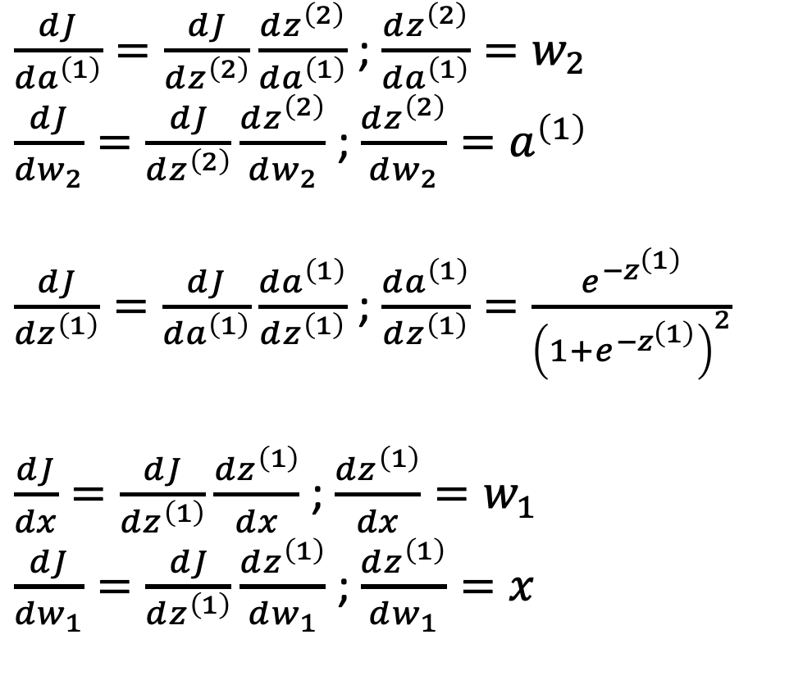
Backpropogation Continued
$$z^{\left(2\right)}=a^{\left(1\right)}∗w_{2}$$
$$a^{\left(1\right)}=\frac{1}{1+e^{−z^{\left(1\right)}}}$$
$$z^{\left(1\right)}=x∗w_{1}$$
$\frac{dJ}{da^{\left(1\right)}}=\frac{dJ}{dz^{\left(2\right)}}\frac{dz^{\left(2\right)}}{da^{\left(1\right)}}$ ; $\frac{dz^{\left(2\right)}}{da^{\left(1\right)}}=w_{2}$
$\frac{dJ}{dw_{2}}=\frac{dJ}{dz^{\left(2\right)}}\frac{dz^{\left(2\right)}}{dw_{2}}$ ; $\frac{dz^{\left(2\right)}}{dw_{2}}=a^{\left(1\right)}$
$\frac{dJ}{dz^{\left(1\right)}}=\frac{dJ}{da^{\left(1\right)}}\frac{da^{\left(1\right)}}{dz^{\left(1\right)}}$ ; $\frac{da^{\left(1\right)}}{dz^{\left(1\right)}}=\frac{e^{−z^{\left(1\right)}}}{{\left(1+e^{−z^{\left(1\right)}}\right)}^{2}}$
$\frac{dJ}{dx}=\frac{dJ}{dz^{\left(1\right)}}\frac{dz^{\left(1\right)}}{dx}$ ; $\frac{dz^{\left(1\right)}}{dx}=w_{1}$
$\frac{dJ}{dw_{1}}=\frac{dJ}{dz^{\left(1\right)}}\frac{dz^{\left(1\right)}}{dw_{1}}$ ; $\frac{dz^{\left(1\right)}}{dw_{1}}=x$

Slide 12
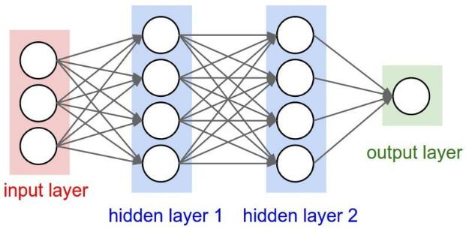


For larger networks
$$a_{j}^{\left(2\right)}=\frac{1}{1+e^{−z_{j}^{(2)}}}$$
$$z_{j}^{\left(2\right)}=\sum_{i}^{h}{a_{i}^{\left(1\right)}w_{ji}^{\left(2\right)}+b_{j}^{\left(2\right)}}$$
$$a_{j}^{\left(1\right)}=\frac{1}{1+e^{−z_{j}^{\left(1\right)}}}$$
$$z_{j}^{(1)}=\sum_{i}^{h}{x_{i}w_{ji}^{\left(1\right)}}+b_{j}^{\left(1\right)}$$
$$\frac{da_{j}^{\left(2\right)}}{dz_{j}^{\left(2\right)}}=\frac{e^{−z_{j}^{\left(2\right)}}}{1+e^{−z_{j}^{\left(2\right)}}}$$
$\frac{d_{z_{j}^{\left(2\right)}}}{d_{w_{ji}^{\left(2\right)}}}=a_{i}^{\left(1\right)}$ ; $\frac{d_{z_{j}^{\left(2\right)}}}{d_{a_{i}^{\left(1\right)}}}=\sum_{j}{w_{ji}^{\left(2\right)}}$ ; $\frac{d_{z_{j}^{\left(2\right)}}}{d_{b_{j}^{\left(2\right)}}}=1$
Etc…

Slide 13
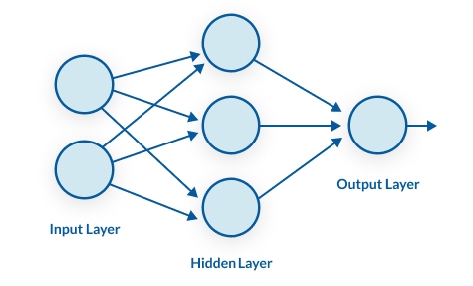








Computational Graphs
$$a^{\left(1\right)}$$
$$σ$$
$$z^{\left(1\right)}$$
+
$$a_{j}^{\left(1\right)}=\frac{1}{1+e^{−z_{j}^{\left(1\right)}}}$$
$$z_{j}^{(1)}=\sum_{i}^{h}{x_{i}w_{ji}^{\left(1\right)}}+b_{j}^{\left(1\right)}$$
$$b^{\left(1\right)}$$
$$∗$$
$$x$$
$$w^{(1)}$$

Slide 14













Computational Graphs
$$\hat{y}$$
$$σ$$
$$z^{\left(2\right)}$$
+
$$b^{\left(2\right)}$$
$$∗$$
$$a^{\left(1\right)}$$
$$w^{(2)}$$
$$σ$$
$$z^{\left(1\right)}$$
+
$$b^{\left(1\right)}$$
$$∗$$
$$x$$
$$w^{(1)}$$

Slide 15
















Computational Graphs
$$J$$
$$L_{2}$$
$$\hat{y}$$
$$y$$
$$σ$$
$$z^{\left(2\right)}$$
+
$$b^{\left(2\right)}$$
$$∗$$
$$a^{\left(1\right)}$$
$$w^{(2)}$$
$$σ$$
$$z^{\left(1\right)}$$
+
$$b^{\left(1\right)}$$
$$∗$$
$$x$$
$$w^{(1)}$$

Slide 16


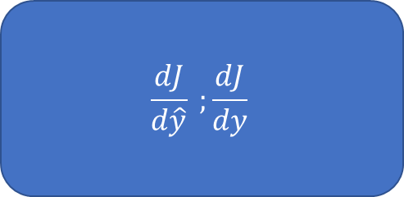







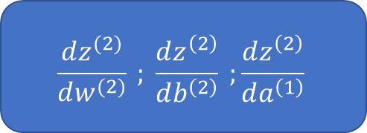









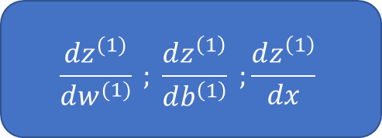
Computational Graphs
$$J$$
$$\frac{dJ}{d\hat{y}} ;\frac{dJ}{dy}$$
$$L_{2}$$
$$\hat{y}$$
$$y$$
$$σ$$
$$\frac{d\hat{y}}{dz^{\left(2\right)}}$$
$$z^{\left(2\right)}$$
+
$$b^{\left(2\right)}$$
$$\frac{dz^{(2)}}{dw^{(2)}} ; \frac{dz^{\left(2\right)}}{db^{\left(2\right)}} ;\frac{dz^{\left(2\right)}}{da^{\left(1\right)}}$$
$$∗$$
$$a^{\left(1\right)}$$
$$w^{(2)}$$
$$σ$$
$$\frac{da^{\left(1\right)}}{dz^{\left(1\right)}}$$
$$z^{\left(1\right)}$$
+
$$b^{\left(1\right)}$$
$$\frac{dz^{(1)}}{dw^{(1)}} ; \frac{dz^{\left(1\right)}}{db^{\left(1\right)}} ;\frac{dz^{\left(1\right)}}{dx}$$
$$∗$$
$$x$$
$$w^{(1)}$$

Slide 17
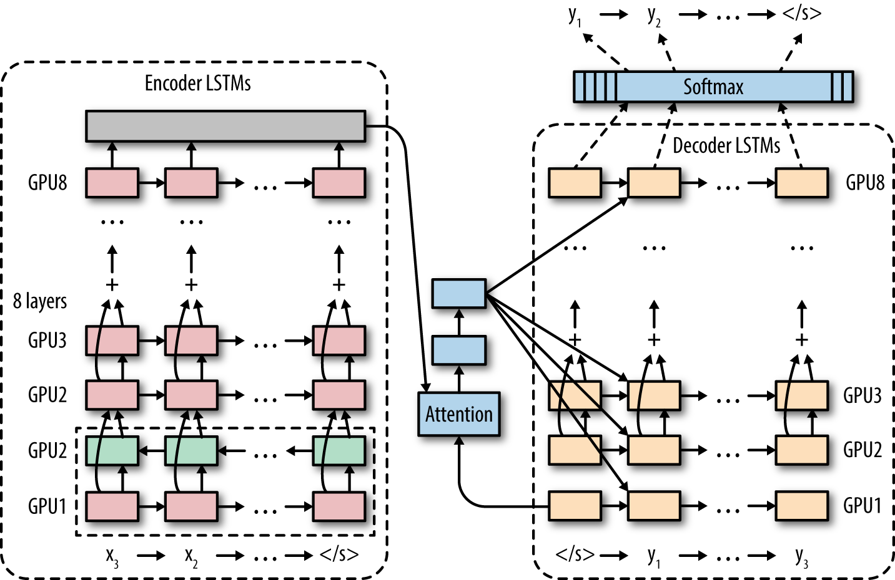
Computational Graphs – Multiple Machines

Slide 18
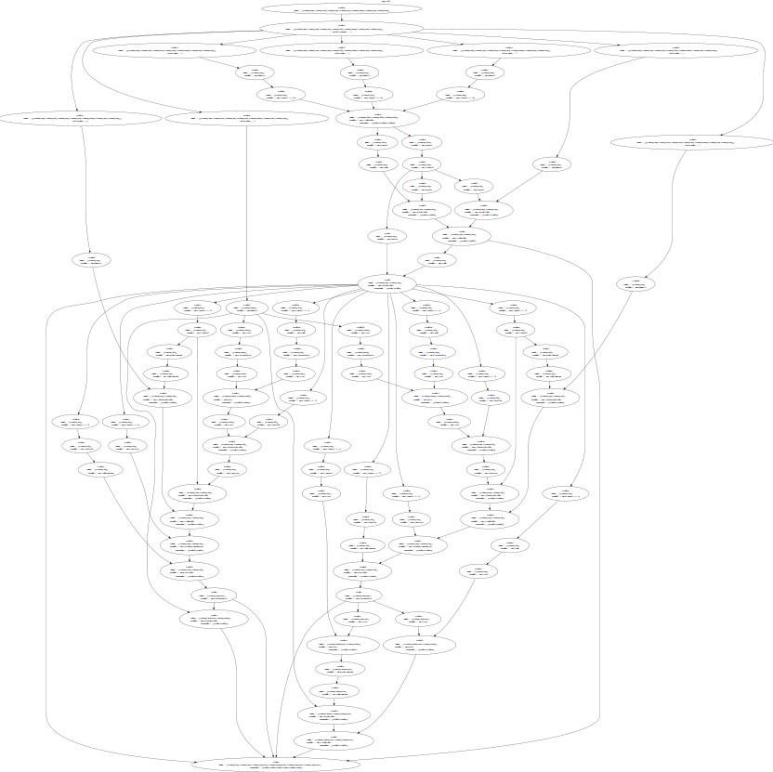
Computational Graph – Complicated Models
Neural Turing Machines - https://arxiv.org/abs/1410.5401

Slide 19
Technical Implementations of Backpropogation
Backpropogation calculation requires all internal activation values are stored in memory
Can become very memory intensive and cause training to fail
Computational graph can become complicated, thus relying on efficient implementation and memory storage
Most backpropogation implementations recommend working with small “batches” of data at a time (i.e. 128 training examples at a time)
Gradient steps are calculated based on only the smaller data set
Saves memory and can improve the final model
Algorithm is known as “mini-batch” stochastic gradient descent

Slide 20
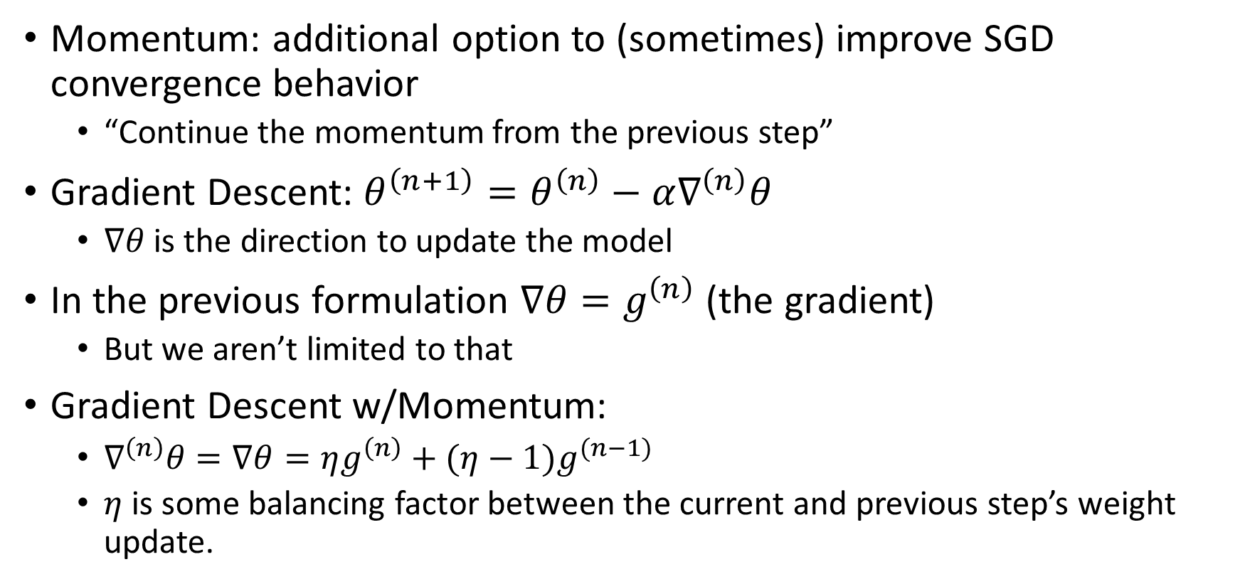
Stochastic Gradient Descent with Momentum
Momentum: additional option to (sometimes) improve SGD convergence behavior
“Continue the momentum from the previous step”
Gradient Descent: $θ^{\left(n+1\right)}=θ^{\left(n\right)}−α∇^{\left(n\right)}θ$
$∇θ$ is the direction to update the model
In the previous formulation $∇θ=g^{\left(n\right)}$ (the gradient)
But we aren’t limited to that
Gradient Descent w/Momentum:
$∇^{\left(n\right)}θ=∇θ=ηg^{\left(n\right)}+(η−1)g^{(n−1)}$
$η$ is some balancing factor between the current and previous step’s weight update.

Slide 21
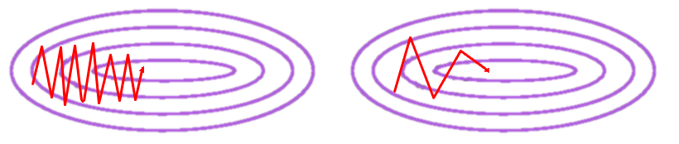
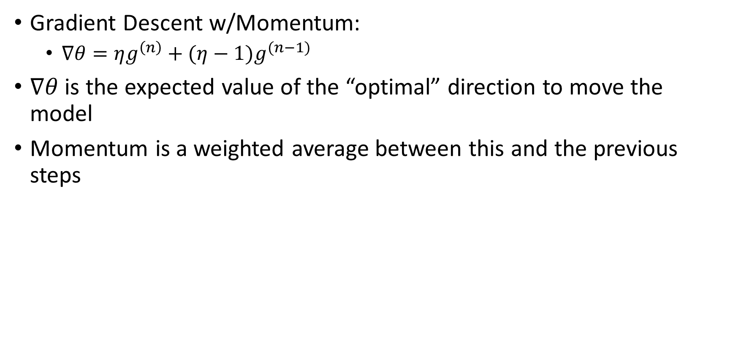
Stochastic Gradient Descent with Momentum
Gradient Descent w/Momentum:
$∇θ=ηg^{\left(n\right)}+(η−1)g^{(n−1)}$
$∇θ$ is the expected value of the “optimal” direction to move the model
Momentum is a weighted average between this and the previous steps
Without Momentum
With Momentum

Slide 22
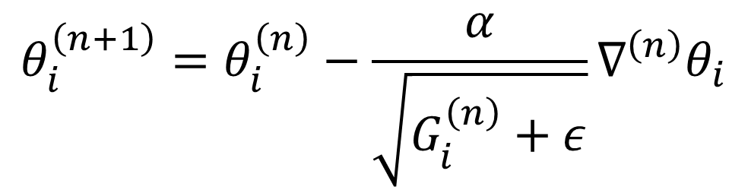
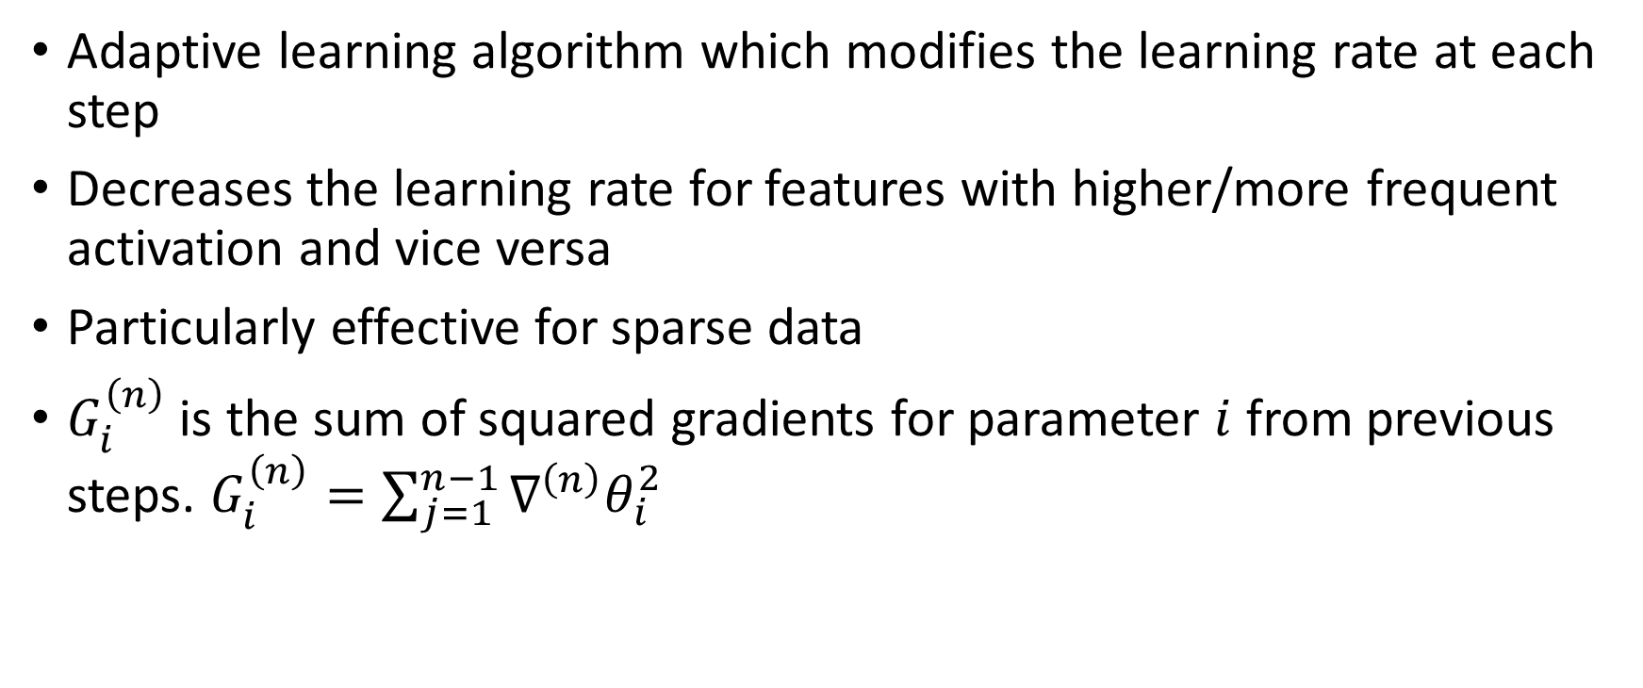
Adagrad
Adaptive learning algorithm which modifies the learning rate at each step
Decreases the learning rate for features with higher/more frequent activation and vice versa
Particularly effective for sparse data
$G_{i}^{\left(n\right)}$ is the sum of squared gradients for parameter $i$ from previous steps. $G_{i}^{\left(n\right)}=\sum_{j=1}^{n−1}{∇^{\left(n\right)}θ_{i}^{2}}$
$$θ_{i}^{\left(n+1\right)}=θ_{i}^{\left(n\right)}−\frac{α}{\sqrt{G_{i}^{\left(n\right)}+ε}}∇^{\left(n\right)}θ_{i}$$

Slide 23
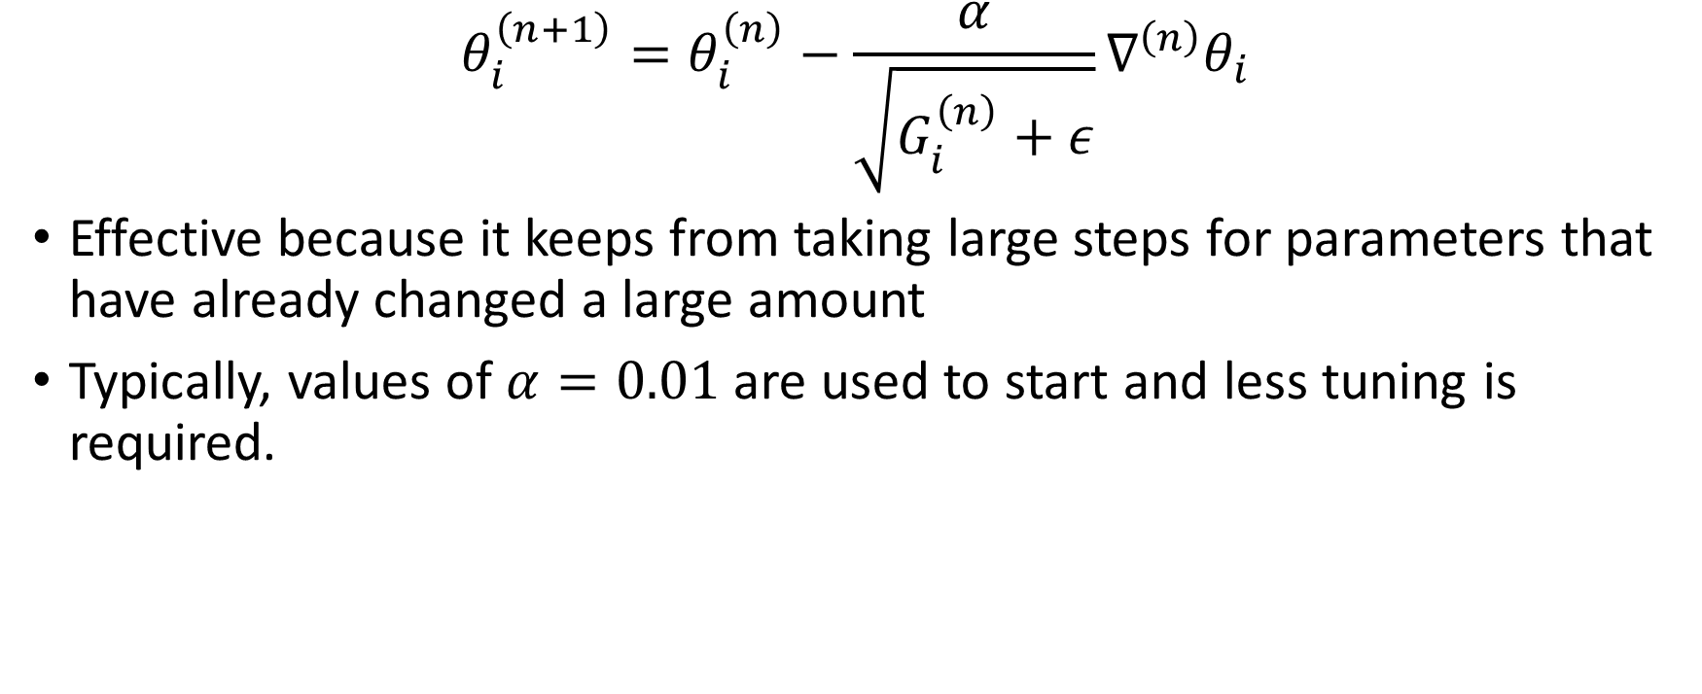
Adagrad
$$θ_{i}^{\left(n+1\right)}=θ_{i}^{\left(n\right)}−\frac{α}{\sqrt{G_{i}^{\left(n\right)}+ε}}∇^{\left(n\right)}θ_{i}$$
Effective because it keeps from taking large steps for parameters that have already changed a large amount
Typically, values of $α=0.01$ are used to start and less tuning is required.

Slide 24
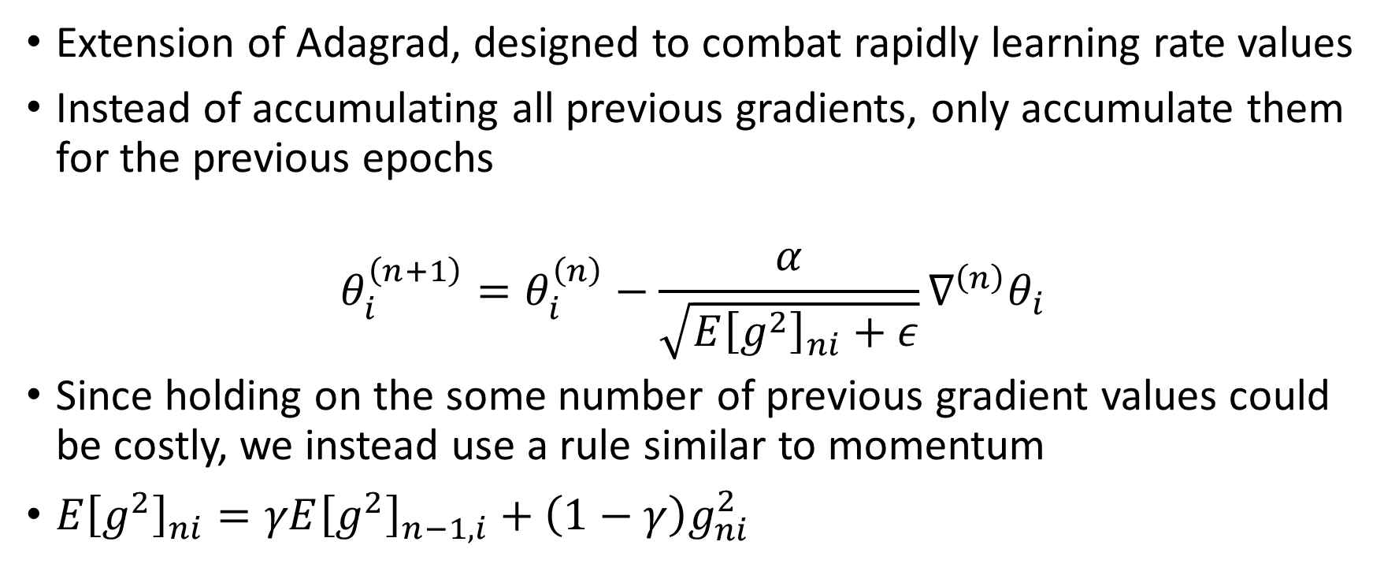
Adadelta
Extension of Adagrad, designed to combat rapidly learning rate values
Instead of accumulating all previous gradients, only accumulate them for the previous epochs
$$θ_{i}^{\left(n+1\right)}=θ_{i}^{\left(n\right)}−\frac{α}{\sqrt{E{\left[g^{2}\right]}_{ni}+ε}}∇^{\left(n\right)}θ_{i}$$
Since holding on the some number of previous gradient values could be costly, we instead use a rule similar to momentum
$E{\left[g^{2}\right]}_{ni}=γE{\left[g^{2}\right]}_{n−1,i}+\left(1−γ\right)g_{ni}^{2}$

Slide 25
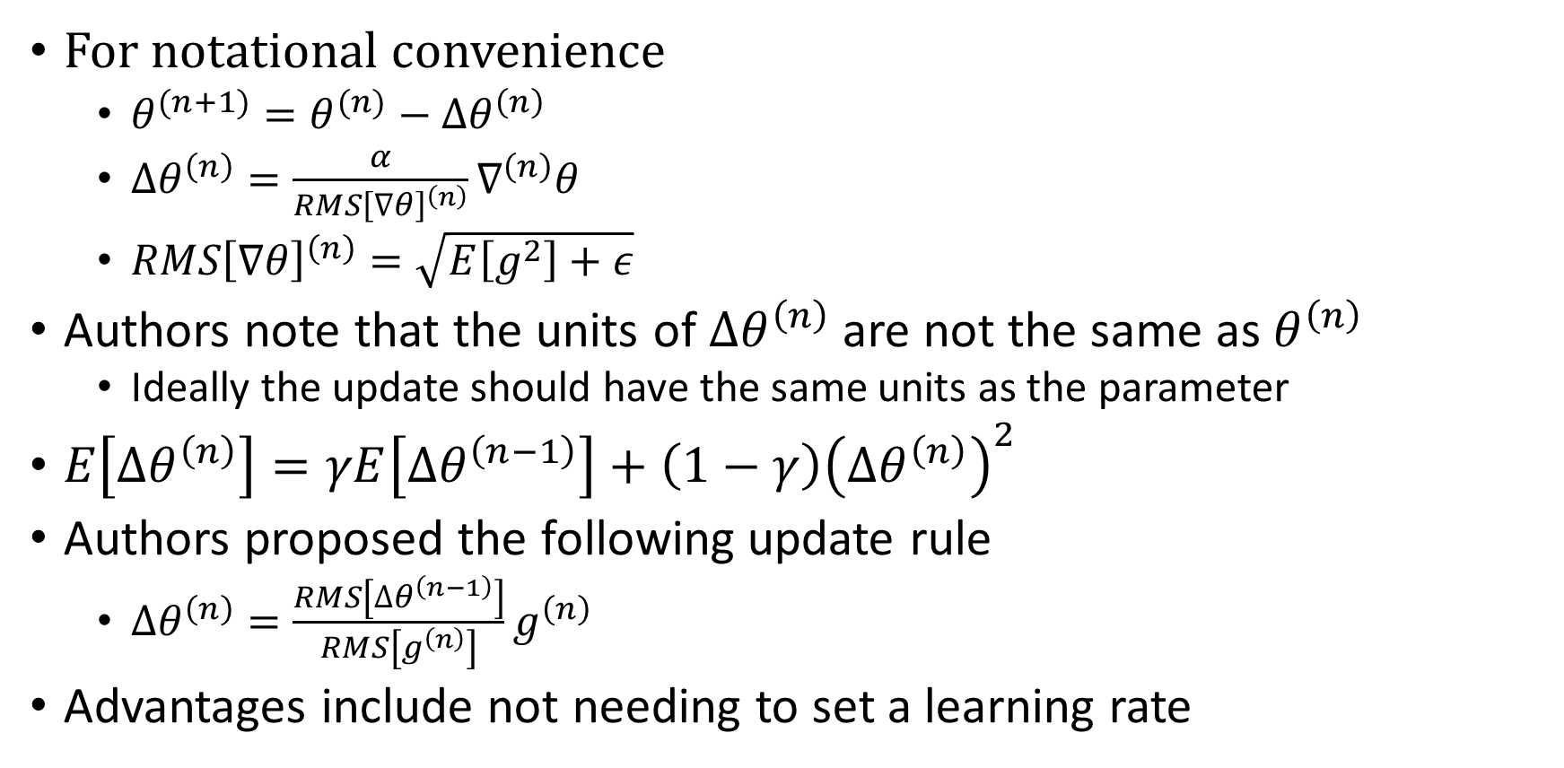
Adadelta
For notational convenience
$θ^{(n+1)}=θ^{(n)}−∆θ^{\left(n\right)}$
$∆θ^{\left(n\right)}=\frac{α}{RMS{\left[∇θ\right]}^{\left(n\right)}}∇^{\left(n\right)}θ$
$RMS{\left[∇θ\right]}^{\left(n\right)}=\sqrt{E\left[g^{2}\right]+ε}$
Authors note that the units of $∆θ^{\left(n\right)}$ are not the same as $θ^{\left(n\right)}$
Ideally the update should have the same units as the parameter
$E\left[∆θ^{\left(n\right)}\right]=γE\left[∆θ^{\left(n−1\right)}\right]+\left(1−γ\right){\left(∆θ^{\left(n\right)}\right)}^{2}$
Authors proposed the following update rule
$∆θ^{\left(n\right)}=\frac{RMS\left[∆θ^{\left(n−1\right)}\right]}{RMS\left[g^{\left(n\right)}\right]}g^{\left(n\right)}$
Advantages include not needing to set a learning rate

Slide 26
Other approaches
RMSProp – Similar to AdaDelta, developed at the same time
Adam – Uses the first and second moments of the gradient to adaptively update the learning rate of each parameter. Very close to RMSProp with momentum.
AdaMax – Adds additional scaling of the second moment of the gradient in Adam
Nadam – Nesterov momentum in Adam
And many others

Slide 27
Which method to choose?
No guarantee that any method will work better than others
Sparse data typically works better with adaptive learning rates
Features which occur more frequently will have a lower learning rate than more sparse features

Slide 28
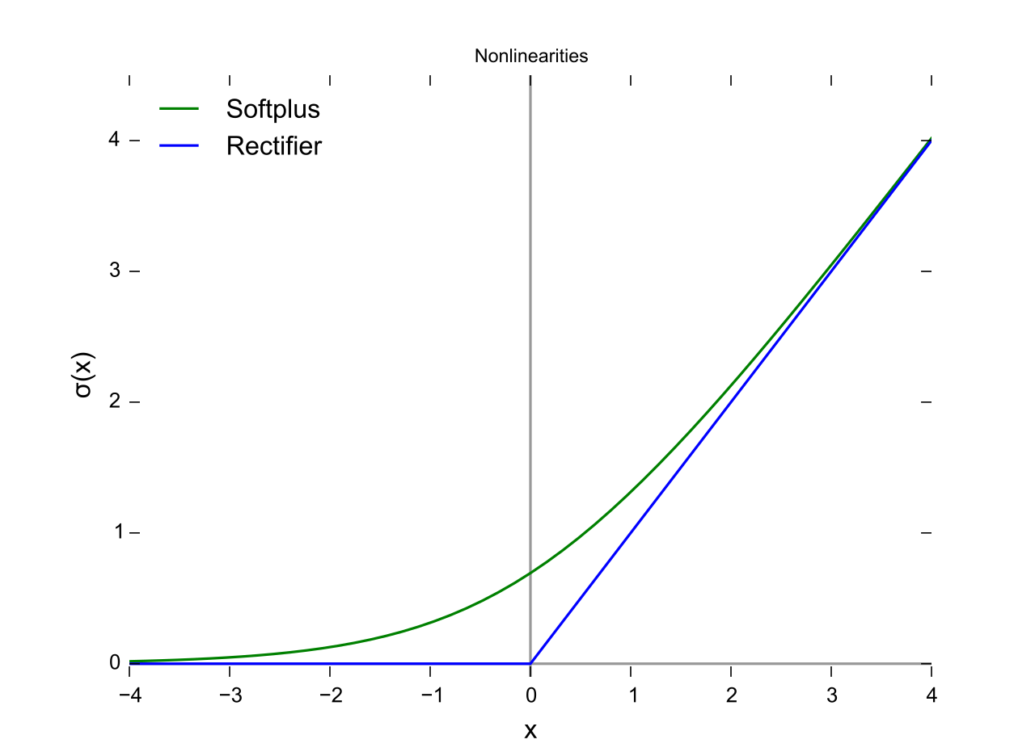

Activation Functions
Sigmoid - $f\left(x\right)=\frac{1}{1+e^{−x}}$
Tanh - $f\left(x\right)=tanh⁡x$
Rectified Linear Unit (ReLU) - $f\left(x\right)=max⁡[x, 0]$
Softplus - $f\left(x\right)=\log{1+e^{x}}$ (integral of sigmoid)

Slide 29

SoftMax Activation
Commonly used for multi-class classification as the last layer
SoftMax - $f_{i}\left(x\right)=p\left(Y=i | x\right)=\frac{e^{x_{i}}}{\sum_{j=1}^{K}{e^{x_{j}}}}$ normalized conditional probabilities

